Slide 1

Winter in the Black Hills
Winter in the Black Hills
Mount Rushmore National Memorial

Slide 2
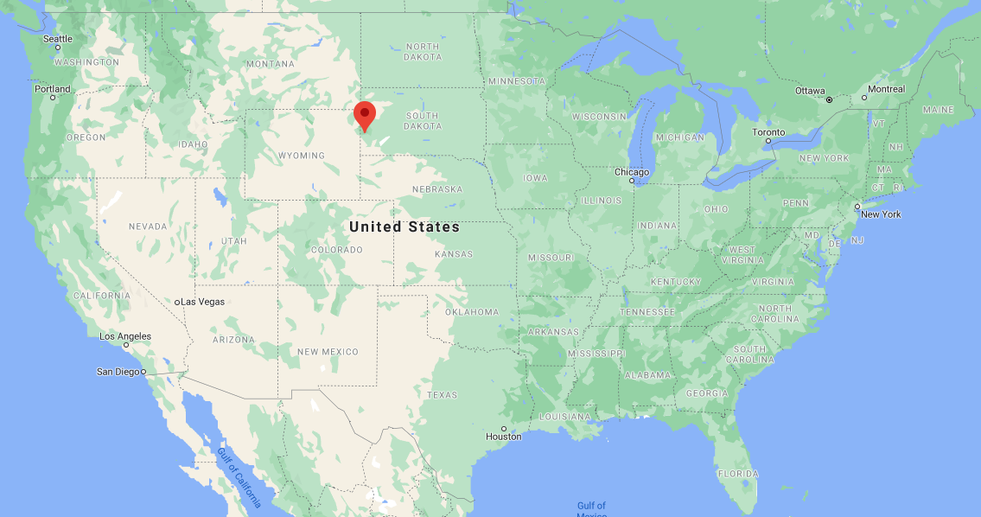
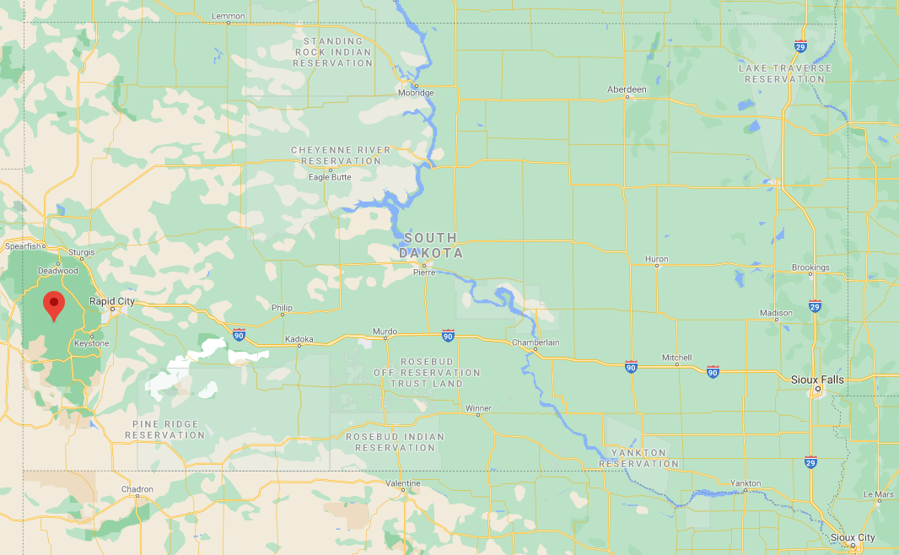
United States and South Dakota Maps

Slide 3
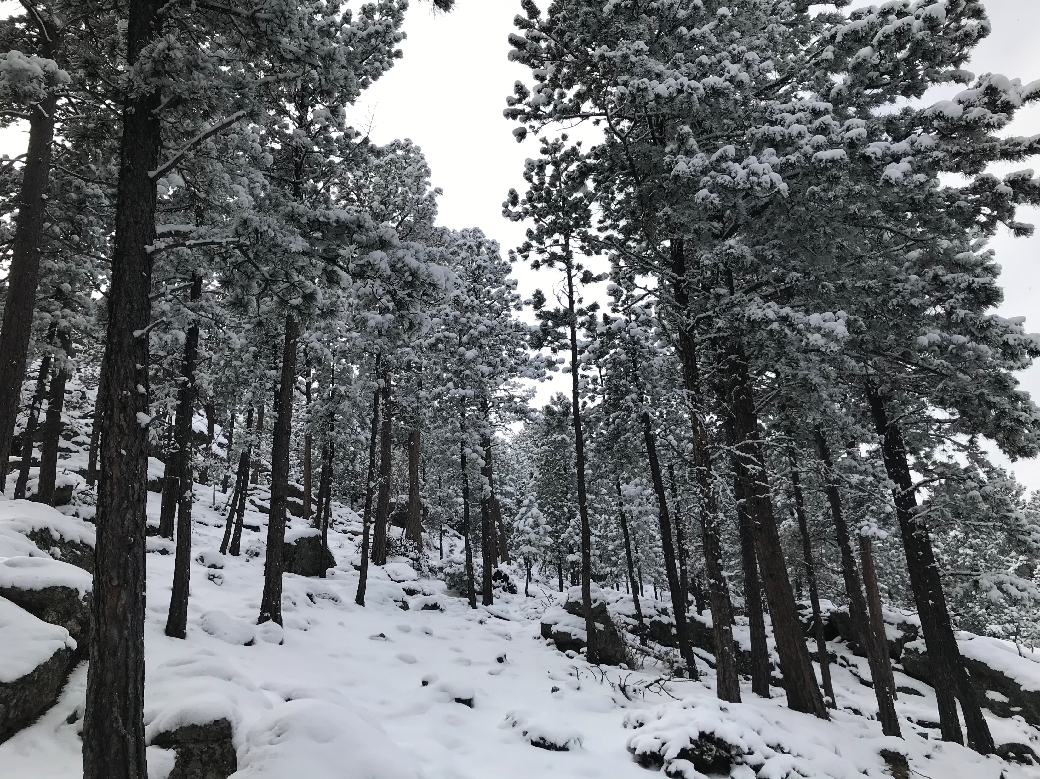
Winter Scene 1

Slide 4
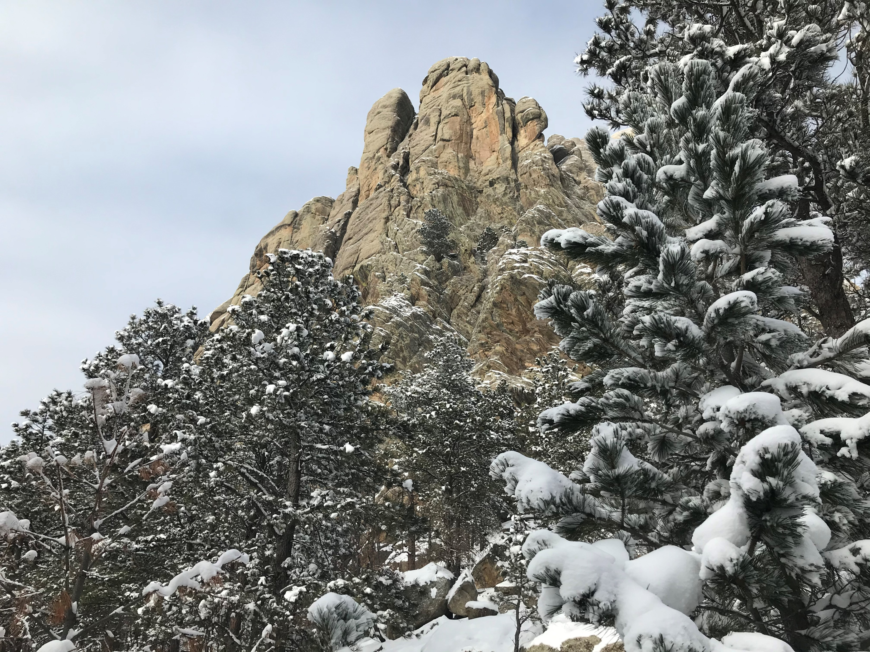
Winter Scene 2

Slide 5
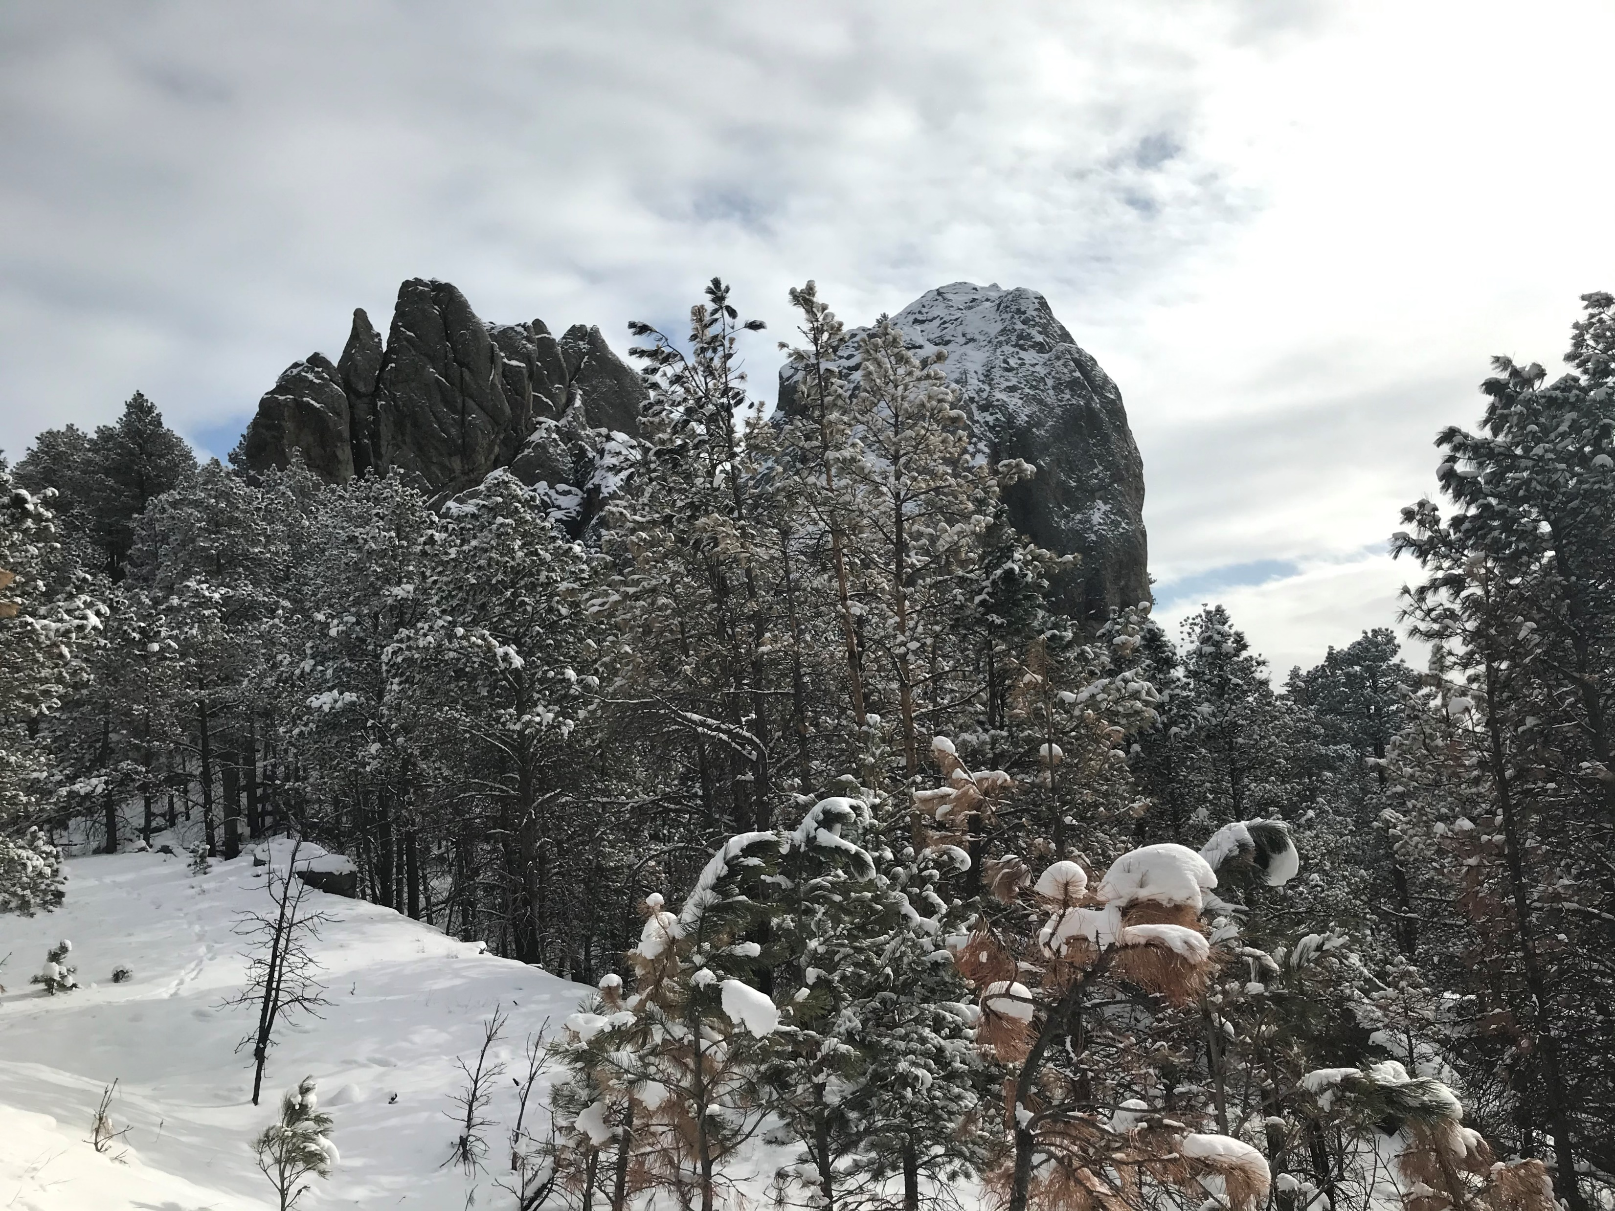
Winter Scene 3

Slide 6
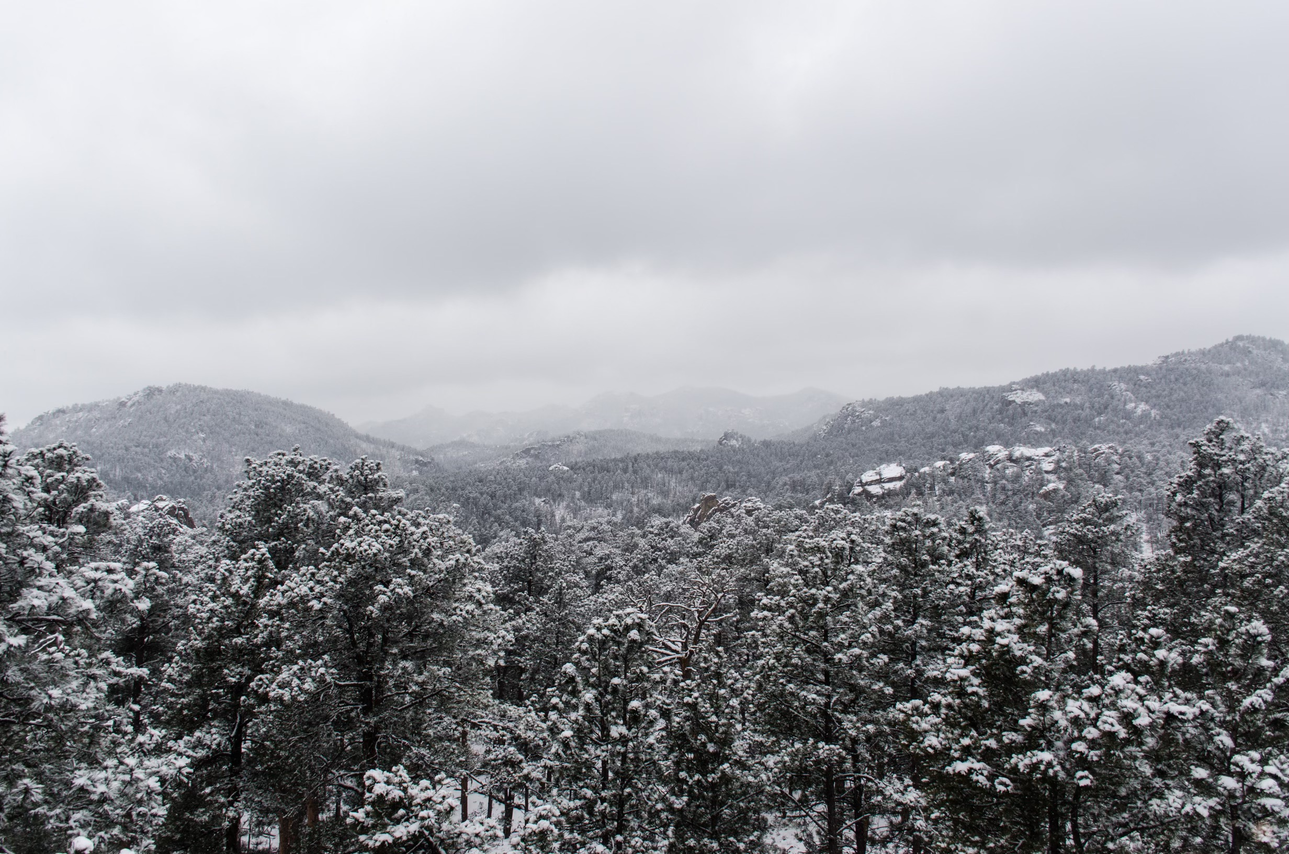
Winter Scene 4

Slide 7
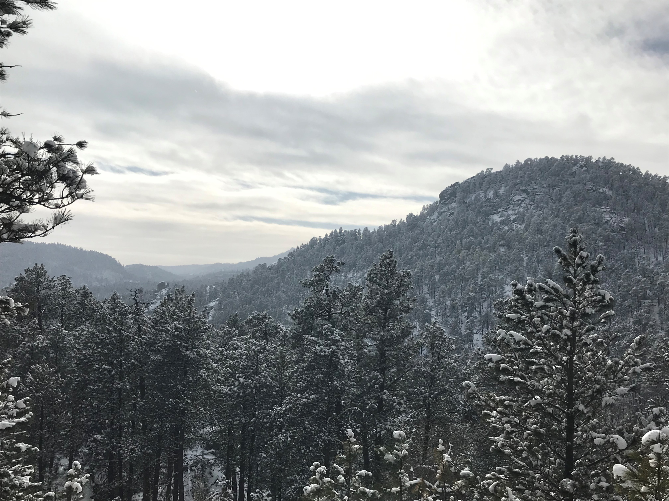
Winter Scene 5

Slide 8
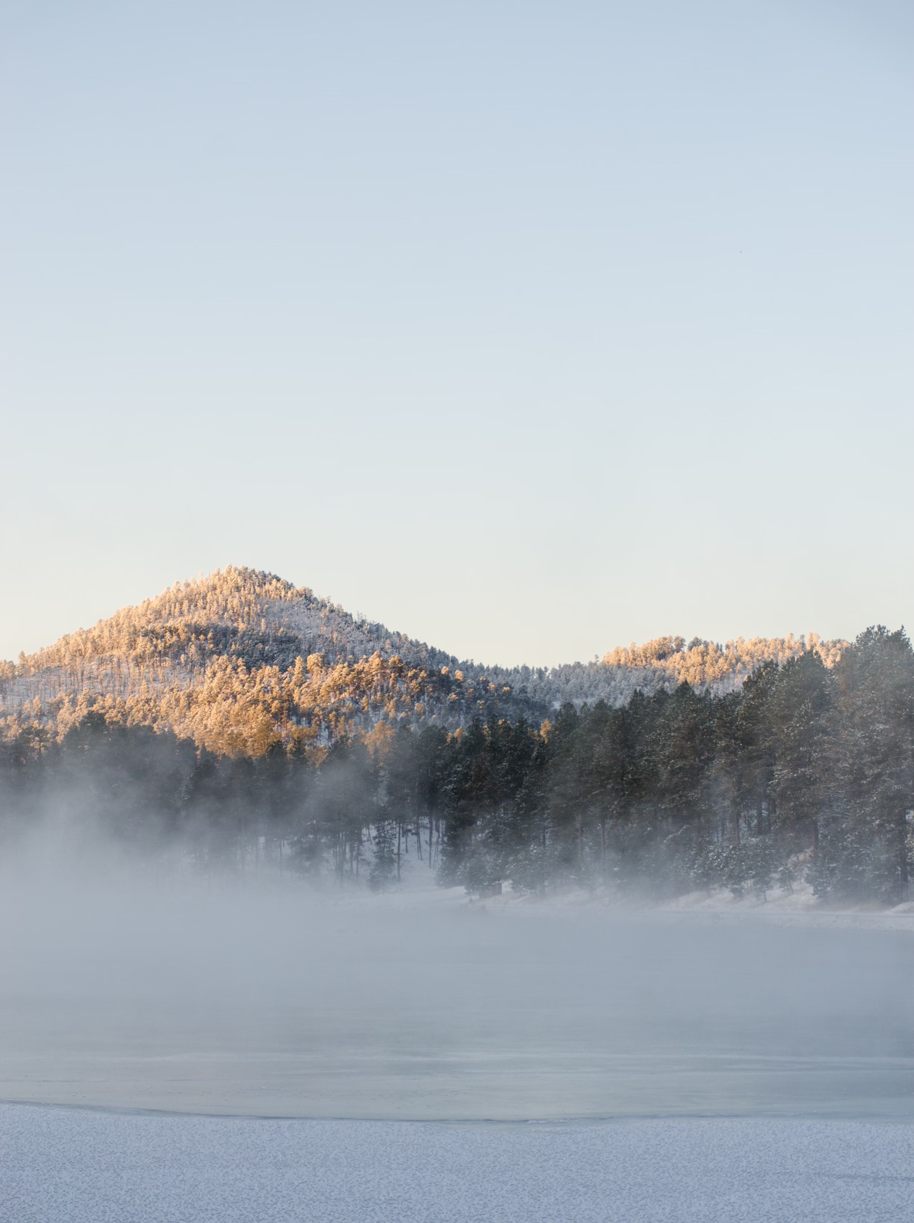
Winter Scene 6

Slide 9
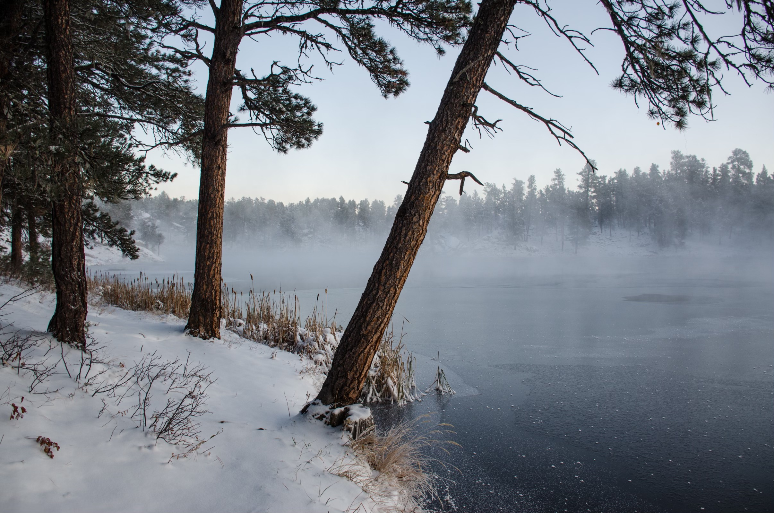
Winter Scene 7

